Slide 1
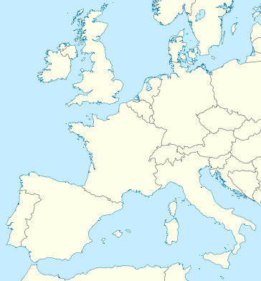
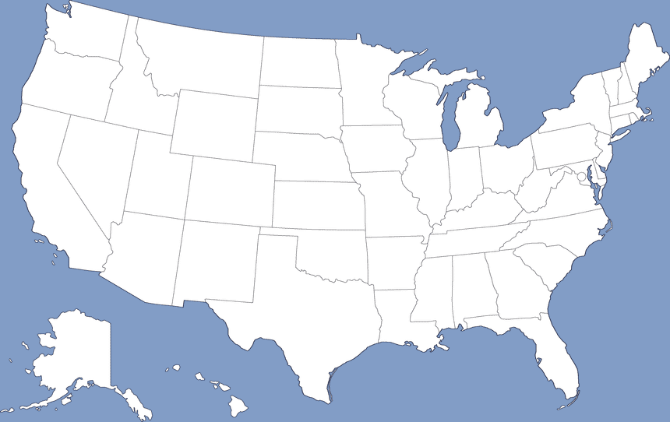
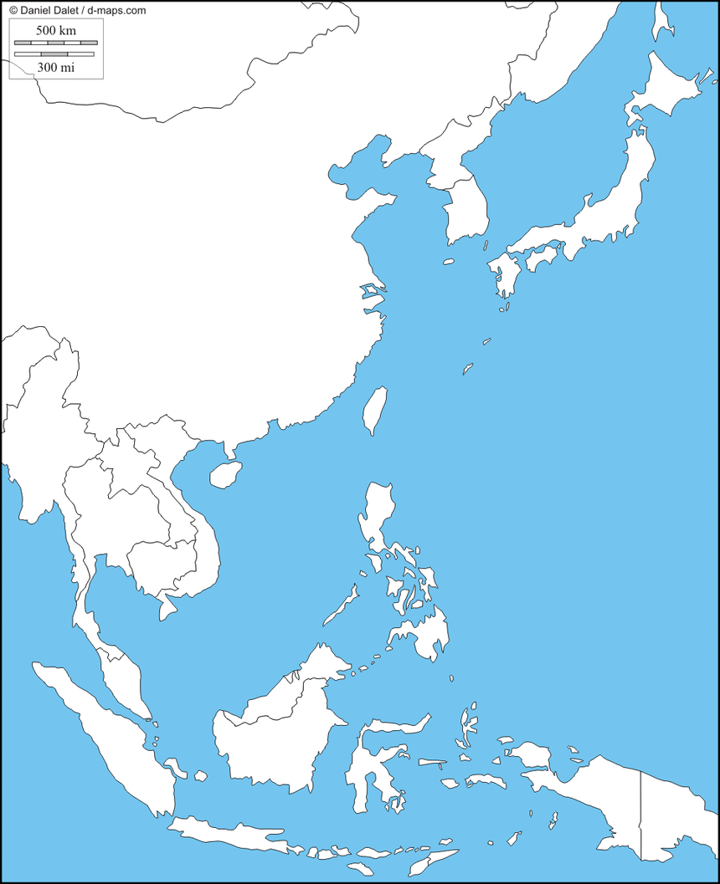


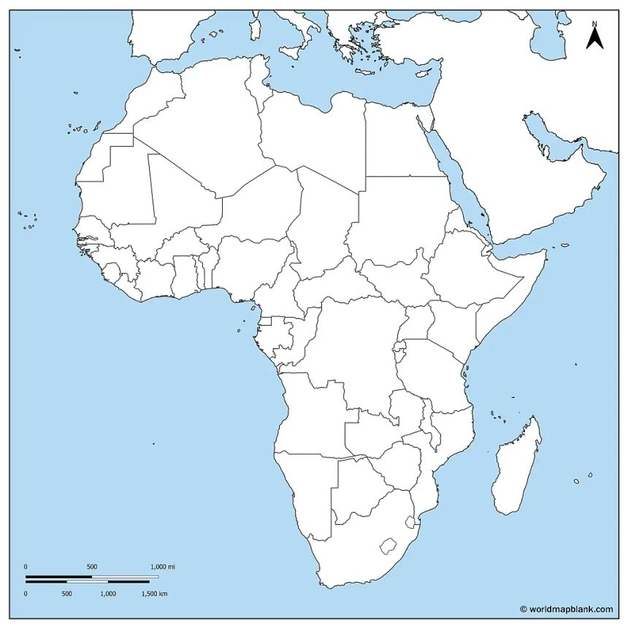
Hurricane Electric 6939​
Carleton - 26557​
China Mobile BEI 9808
Hetzner 24940
Stanford 32​
Google 15169
Google Kansas City Hub​​
396982​​
​​
China Mobile HK 58453
CENIC 2153
Tenet 2018
Notes:
**Key Takeaways*** The U.S. and Western Europe are **best connected**; China and South Africa show **high latency and long routes**.* All traffic from Carleton passes through a **Midwestern hub**, likely Kansas City.* **Stanford’s route** had many hops — large networks add routing complexity.* **China and South Africa paths** show major delays from **transoceanic distance**.* Smaller sites like **corndog.io** revealed **unreliable or missing routes**.* Latency mostly follows **distance**, but network design also matters.

